Slide 1
VOLTAINFO GROUP HOUSEHOLD ELECTRICITY CONSUMPTION MONITORING

Slide 2
Problem Statement
Insufficient information regarding energy consumption, which has led to complains from Kenyan households about high electricity bills that they can’t account for Since they don’t have a way of monitoring their electricity usage.

Slide 3
Middle class individual's or household's daily income ranges between KSh1,031 and KSh5,158 per person per day. This works out to an average income of Sh27,000 to Sh140,000 a month. PERSONA Name: Janice Wakere Age: 25 years Gender: Female Education: Business Management College graduate Occupation: Supermarket Cashier Work Location: Kenyatta Avenue Income: Ksh 50000 Daily Spend: Ksh 200 Residence: Kikuyu Marital Status: Single Dependents: 2 Children
TARGET CUSTOMER

Slide 4
Need For Solution
Change in consumption
Lower electricity bill
Better electricity management
Clear Budgeting

Slide 5
Pre-paid meter Customers
Target Customer Research Findings

Slide 6
Post-paid meter Customers
Target Customer Research Findings

Slide 7
Solution
Monitor the consumption of electricity.
Product Components
Acs712 Current Sensor
ESP8266-01 Wifi Module
Buck Converter

Slide 8
Practical Business Issues
Rent
Licenses
Internet
Marketing Process
Advertisement

Slide 9
RENT
Nairobi Garage
Fixed plan = 25000 Flexi Plan = 20000
Security Deposit = 29000 Security Deposit = 23200
Subtotal = 54000 Subtotal = 43200
Tax on Sales(16%) = 4000 Tax on Sales(16%) = 3200
Total = 58000 Total = 46400
Deposit = 25000 Deposit = 20000
Total cost = 83000 Total cost = 66400

Slide 10
Governance
Kenya Power owns and operates most of the electricity transmission and distribution system in the country and sold electricity to over 6,761,090 million by end of June 2018.
The Company’s key mandate is to plan for sufficient electricity generation and transmission capacity to meet demand; building and maintaining the power distribution and transmission network and retailing of electricity to its customers.
The Government has a controlling stake at 50.1% of shareholding with private investors at 49.9%. Kenya Power is listed on the Nairobi Securities
Kenya Power believes in integrity and delivering on our promises.
Kenya Power is committed to provide cost effective, reliable and quality power that delights customers and betters peoples lives.

Slide 11
Competitors Research Type
Competitor 1
Competitor 2
Observation
Desk Research and Phone Call

Slide 12
INTERNET PROVIDERS
Zuku
Safaricom
Airtel
Orange
Faiba Internet and a bunch of others

Slide 13
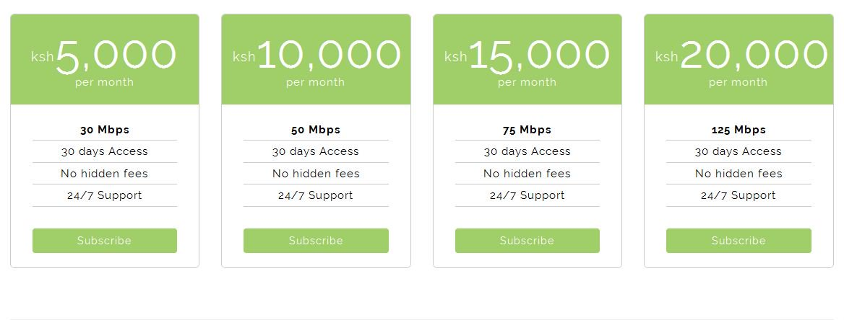
Faiba Internet

Slide 14
Solution
Our solution entails designing a product that will measure the current from the different fuse lines supplying power to a house. The information will later be displayed to the consumer, this will allow the consumer to regulate how much energy he/she wants to use, and in return this will help them save on money.

Slide 15
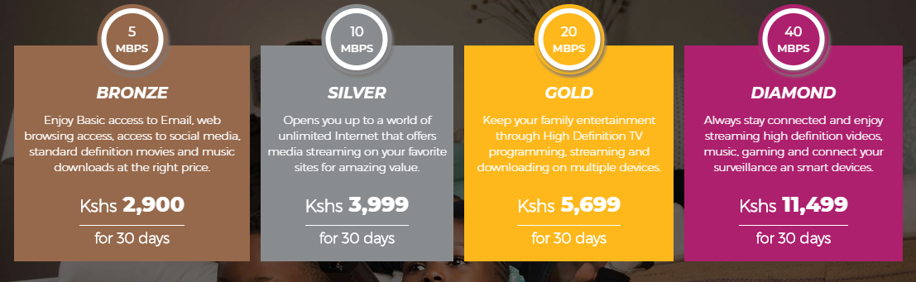
Safaricom Internet

Slide 16
Internet
Internet speed (download) | Number of connected users/devices | What you can do
5 Mbps | 1 or 2 | Online browsing, research, email
25 Mbps | 3 to 5 | Large-file downloading, basic Wi-Fi, business communication
75 Mbps | 5 to 10 | Video streaming, frequent file sharing, numerous POS transactions
150 Mbps | 10 to 15 | Frequent cloud computing, video conferencing, data backups
250 Mbps | 15 to 20 | Server hosting, seamless streaming and conferencing
500 Mbps | 20 to 30 | Multiple-server hosting, constant cloud-based computing, heavy online backups
1 Gbps (1,000 Mbps) | 30+ | Extreme-speed operating for enterprise-ready offices with near-zero interruptions

Slide 17
Licenses
Business Registration Certificate
County Business Permit
Certificate of Incorporation

Slide 18
Advertisement
Radio5 times per day for 5 days at USD 10 each
TVUSD 7500 per week according to quora.com
Billboards10 by 12 metre at Ksh 160000 in Nairobi by Community Authority of Kenya
Billboards are basically ranging between ksh 160000 to ksh 200000
Firm advertising is ksh 350000
AdWordsSmall businesses is USD 90 - 10 per month
1-2 $ pay per click (Google Search Network)
Kshs 10 pay per click(BRCK)

Slide 19
Advertisement
TELEVISIONS
CITIZEN TV
Programme sponsorship Screening once per week – Kshs 750,000
Programme sponsorship Screening more than once per week- Kshs 1,100,000
7pm Clock- Kshs 1,265,000
9pm Clock- Kshs 1,265,000

Slide 20
Advertisement
RADIOS
CITIZEN
6:00am-10:00am- Kshs 1,200,000
10:00am-1:00pm- Kshs 770,000
1:00pm-4:00pm- Kshs 770,000
4:00pm-8:00pm- Kshs 1,000,000
After 8.00pm- Kshs 770,000
Roga Roga- Kshs 1,000,000

Slide 21
Advertisement
RADIOS
RAMOGI
6:00-10:00am- Kshs 1,000,000
10:00am-1:00pm- Kshs 550,000
1:00pm-4:00pm- Kshs 550,000
4:00pm-8:00pm- Kshs 850,000
After 8.00pm- Kshs 550,000

Slide 22

Competitor 1
Kenya Power & Lighting Company
Services
Smart Meters
Post-paid Meters
Pre-paid Meters

Slide 23

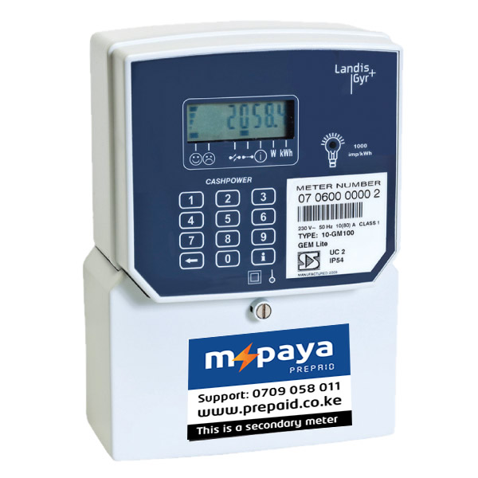
Competitor 2
Services
M-Paya provides a secondary Prepaid meters that are used by Landlords to collect electricity usage payments from tenants.
Secondary prepayment meters are used by Landlords to control, measure and track the electricity usage of their tenants.
Tenants may top-up their secondary prepayment meters at their convenience.

Slide 24
Electricity Monitoring Overall Research Findings
Our group conducted research at the middle income areas such as Uthiru, 87, Mountain View, Thion’go, Muthiga, Regen, Kikuyu and Kinoo.
From the feedback we got from the residents it showed that some of them didn’t realize that this was a problem as they did not mind about getting information on their electricity consumption, where else others expressed interest in having that information.
We also visited Electricity House in Town where we inquired about Kenya Power smart meter technology. From the information that we got, we realized that Kenya Power is in piloting the smart meters are in very few households outside of Nairobi and still haven’t decided on how long it will take to deploy the smart meter technology.

